Slide 1
Introduction to Bioinformatics
In the name of the most high
Phylogenetic Trees
Ali Sharifi-Zarchi
Department of Computer Engineering, Sharif University of Technology
These slides are available under the Creative Commons Attribution License.

Slide 2
Red Pandas Problem

Slide 3
Red Pandas

Slide 4
Burrows Wheeler Transform (BWT)
$babaabdad
aabdad$bab
abaabdad$b
abdad$baba
ad$babaabd
baabdad$ba
babaabdad$
bdad$babaa
d$babaabda
dad$babaab
babaabdad$

Slide 5
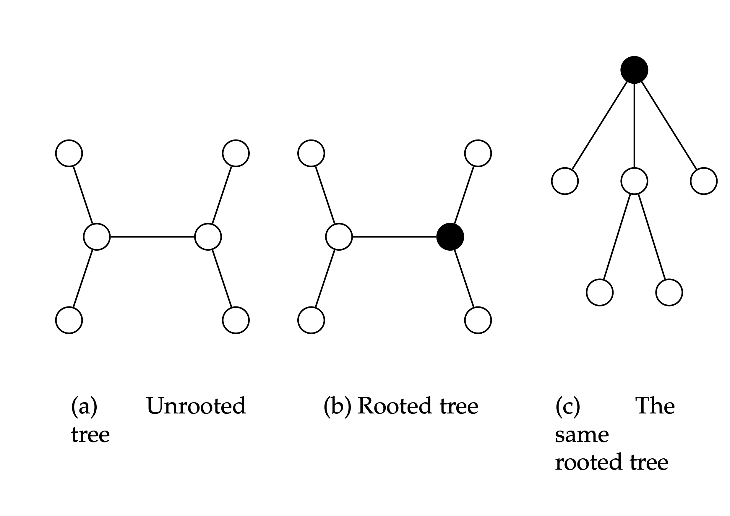
Trees

Slide 6
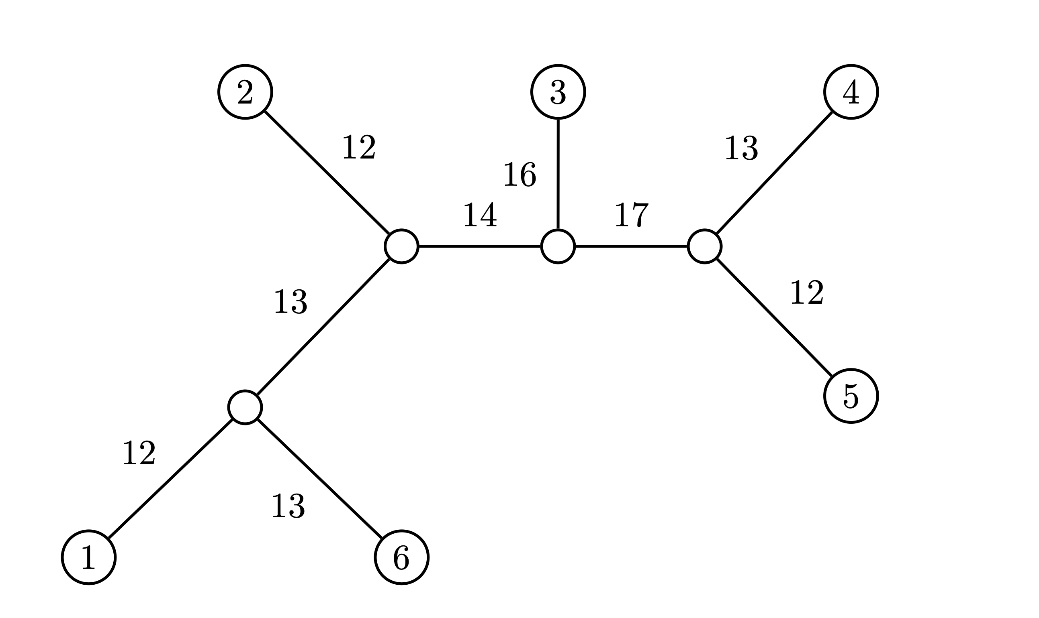
Weighted Trees

Slide 7
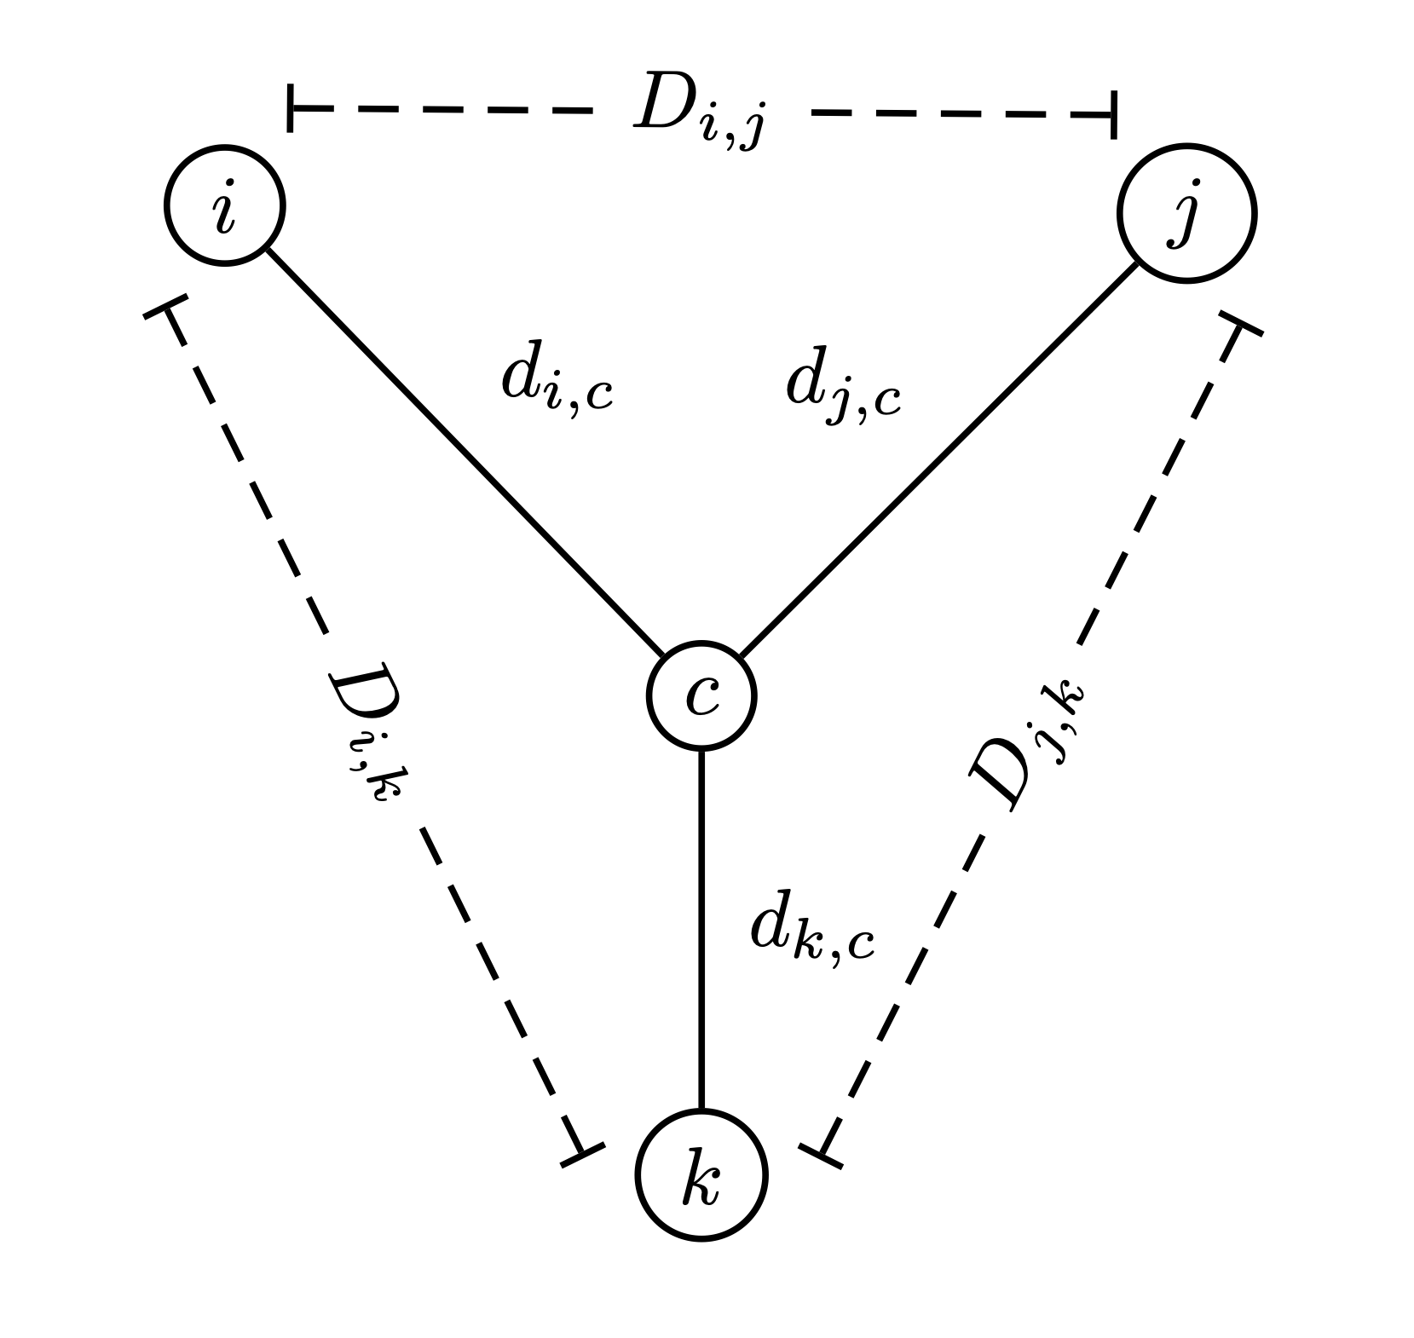
Distance Based Tree Reconstruction

Slide 8
Distance Based Tree Reconstruction

Slide 9
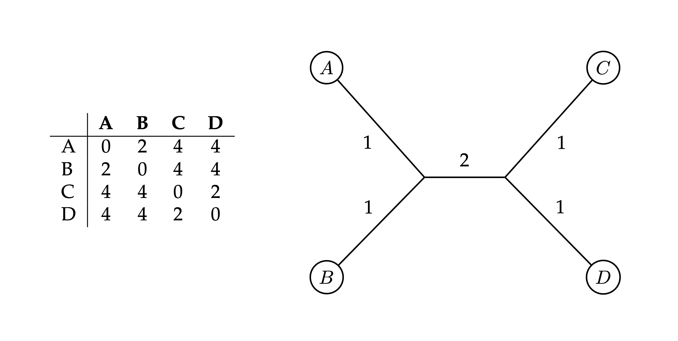
Additive Matrix

Slide 10
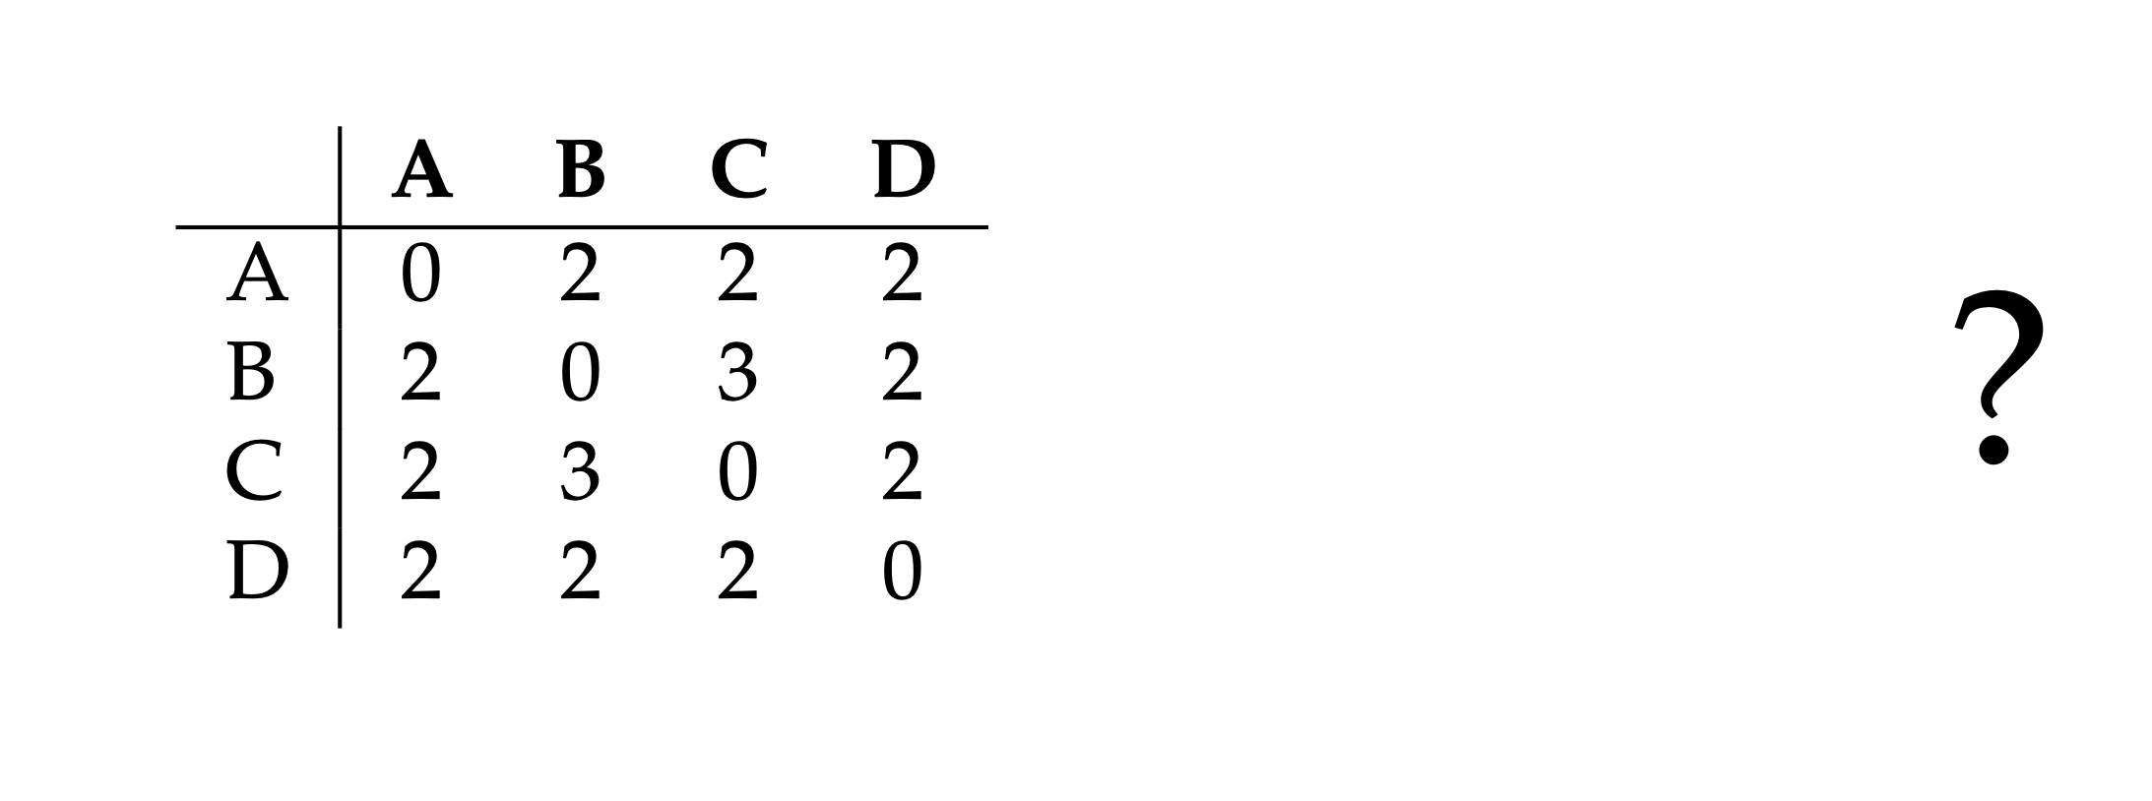
Non-Additive Matrix

Slide 11
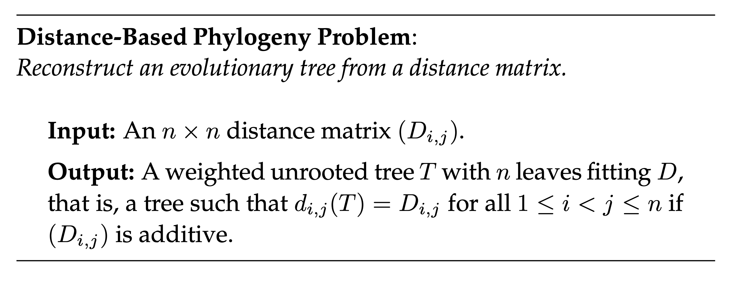
Distance Based Phylogeny

Slide 12
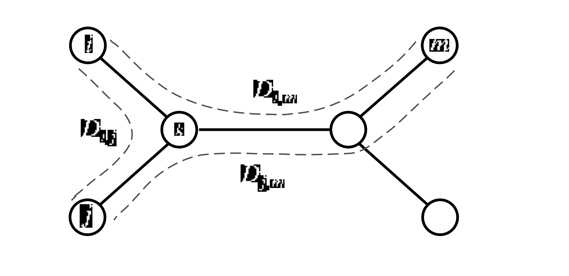
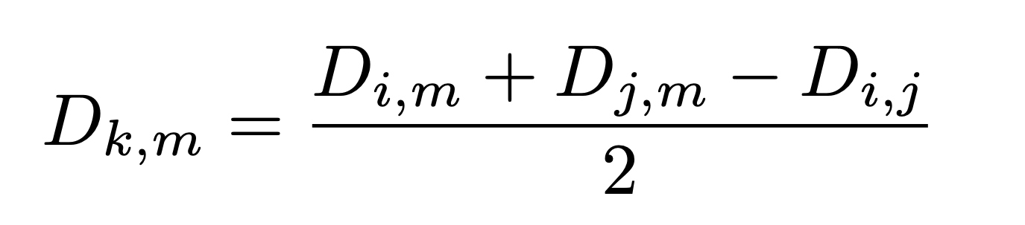
From Additive Matrix

Slide 13
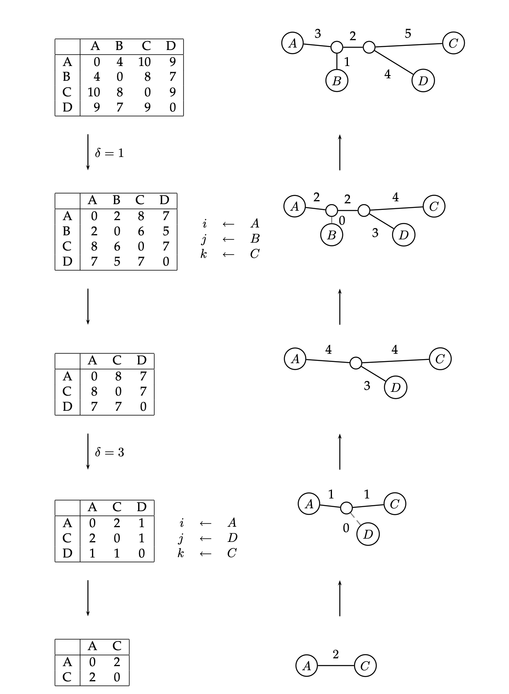
Strategy

Slide 14
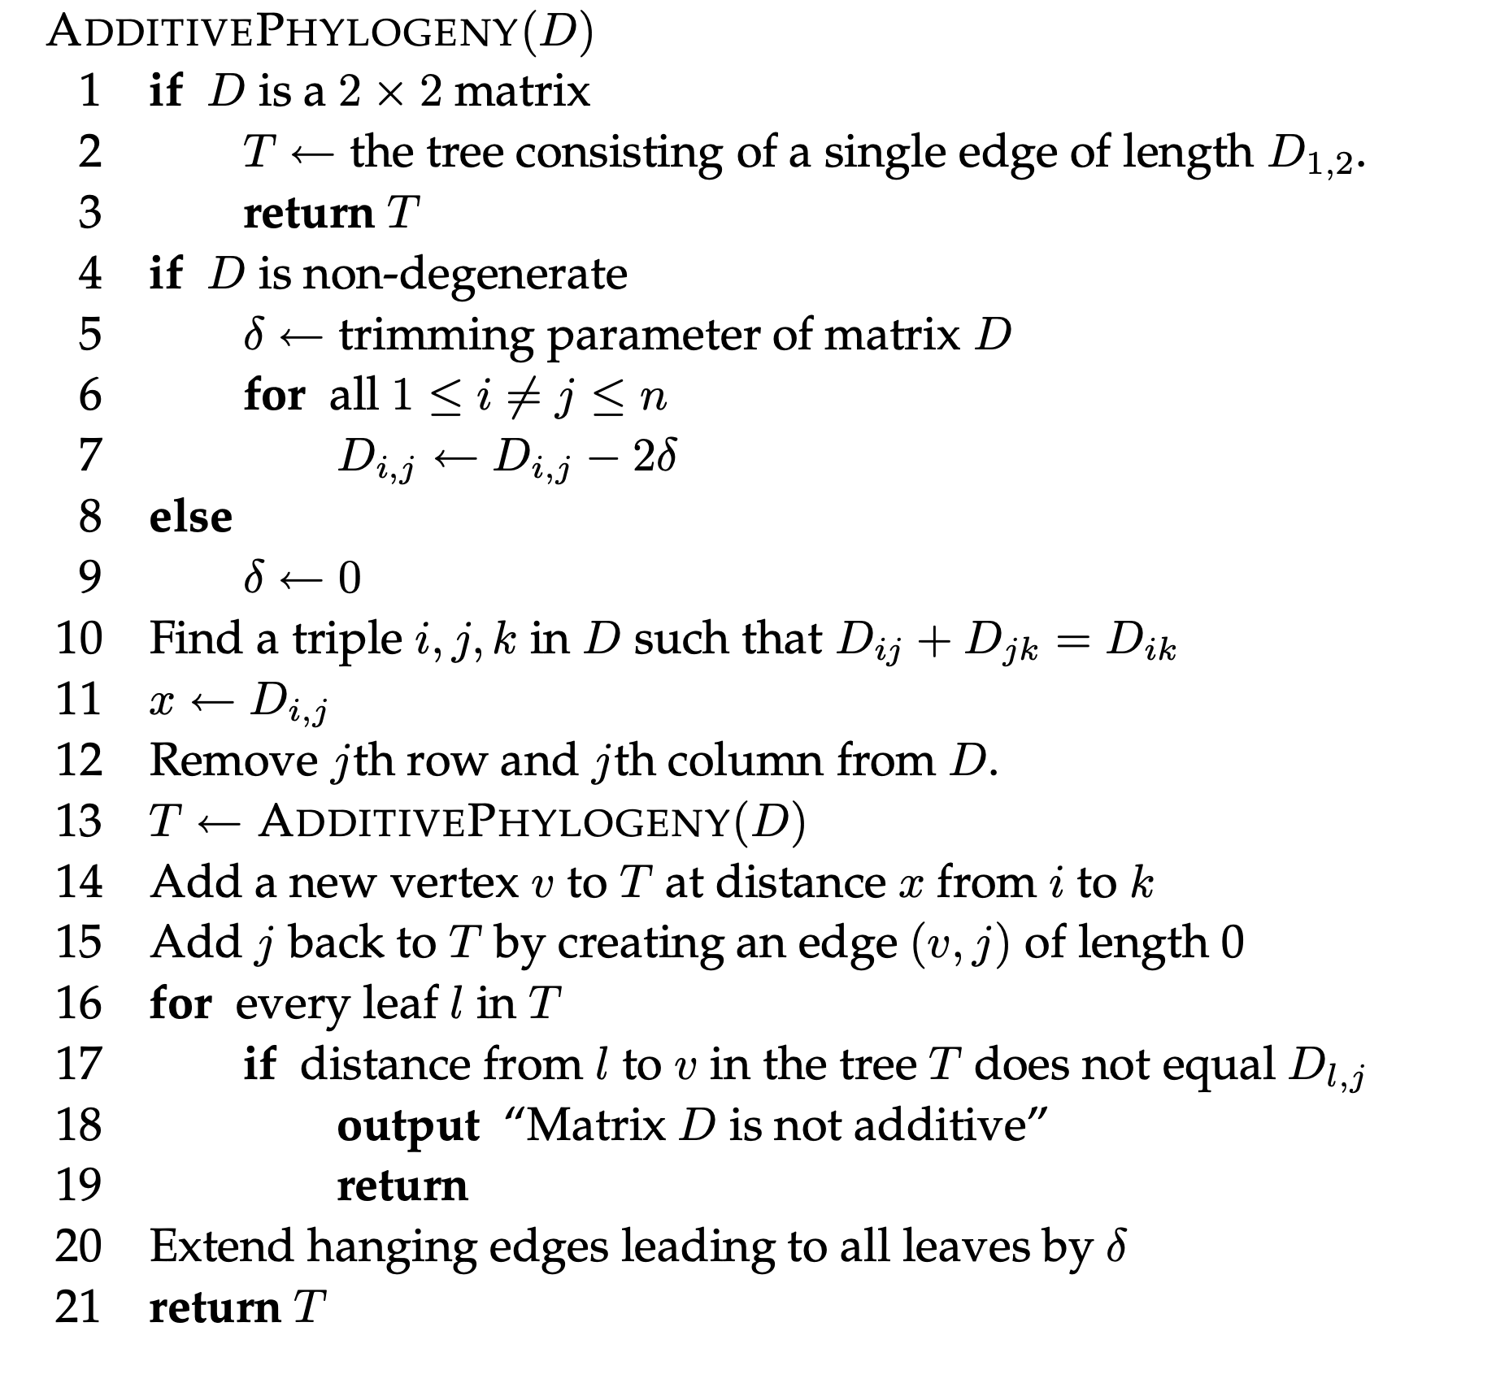
Strategy

